Slide 1
PL/SQL Programming – Intermediate

Slide 2
Course Objectives
Joins
PL/SQL Fundamentals
Exception Handling
Cursors
Procedures
Functions
Packages
Performance Tuning

Slide 3
Session Objectives
Exception Handling

Slide 4
Exception Handling

Slide 5
Exception Handling
What is Exception ?
In PL/SQL, a warning or error condition is called an exception.
Exceptions can be internally defined (by the run-time system) or user defined.
Declare
--------
Begin
--------
--------
--------
--------
--------
--------
End;

Slide 6
Exception Handling
When an error occurs, an exception is raised. That is, normal execution stops and
control transfers to the exception-handling part of your PL/SQL block or subprogram.
Declare
--------
Begin
--------
--------
--------
--------
--------
--------
Exception
--------
--------
End;
Declare
--------
Begin
--------
--------
--------
--------
--------
--------
Exception
--------
--------
End;

Slide 7
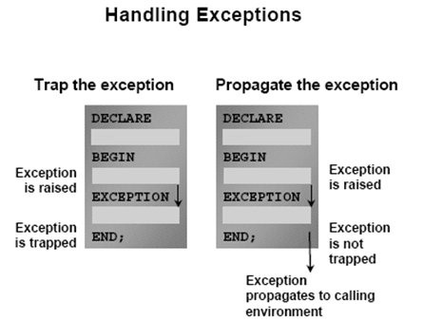
Exception Handling Contd..

Slide 8
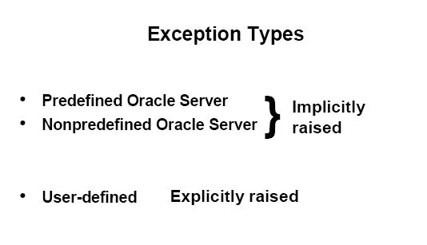
Exception Handling Contd..
Errors can be handled by the system or by the user
Exception Types

Slide 9
Exception Handling Contd..
Exception Types and Their description
Exception | Description
Predefined Exceptions | Raised Implicitly whenever a PL/SQL program violates the Oracle rule or exceeds a system-dependent limit
Non-Predefined Exceptions | Declared in the declaration section corresponding to the oracle error number and raised implicitly
User defined Exceptions | Declared in the declaration section and raised explicitly using RAISE statements

Slide 10
Exception Handling - by the user
Trapping Exceptions
Exceptions can be trapped by including corresponding routine in the exception-handling section of the PL/SQL block.
Each handler consists of a WHEN clause, which specifies an exception, followed
by sequence of statements to be executed when that statement is raised.
Syntax
EXCEPTION
WHEN exception1 or [exception2…] THEN
statement1;
statement2;
[WHEN exception3 or [exception4…] THEN
statement1;
statement2;]
[WHEN OTHERS THEN
statement1;
statement2;
…]

Slide 11
Predefined Exceptions
Trapping Predefined Oracle Errors
Predefined exceptions can be trapped by referencing its standard name in
the corresponding exception handling routine
Exception Name | Oracle Server Error No
ACCESS_INTO_NULL | ORA-06530
CASE_NOT_FOUND | ORA-06592
INVALID_NUMBER | ORA-01722
PROGRAM_ERROR | ORA-06501
TOO_MANY_ROWS | ORA-01422
ZERO_DIVIDE | ORA-01476

Slide 12
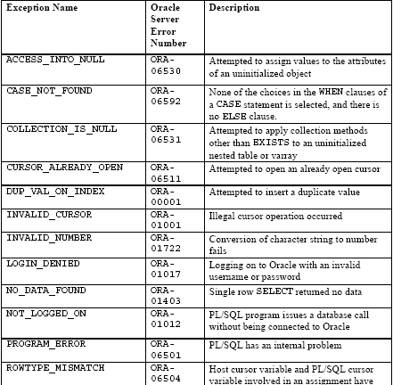
Predefined Exceptions

Slide 13
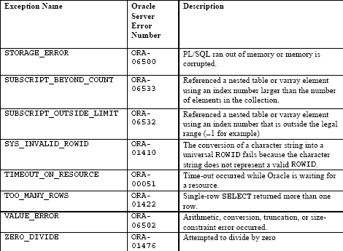
Predefined Exceptions

Slide 14
Predefined Exceptions
Example
BEGIN
SELECT ...
SELECT ...
SELECT ...
...
EXCEPTION
WHEN NO_DATA_FOUND THEN -- catches all ’no data found’ errors
…
WHEN TOO_MANY_ROWS THEN– catches all ‘too many rows’ errors
…
WHEN OTHERS THEN– catches all other unhandled errors
…

Slide 15
Non Predefined Exceptions
Trapping Non Predefined Oracle Errors
To handle error conditions (typically ORA- messages) that have no predefined name, you must use the OTHERS handler or the pragma EXCEPTION_INIT.
A pragma is a compiler directive that is processed at compile time, not at run time. In PL/SQL, the pragma EXCEPTION_INIT tells the compiler to associate an exception name with an Oracle error number, That lets you refer to any internal exception by name and to write a specific handler for it.
Syntax
Exception EXCEPTION;
PRAGMA EXCEPTION_INIT(exception,-Oracle error number);

Slide 16
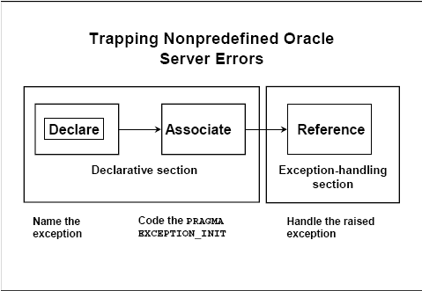
Non Predefined Exceptions

Slide 17
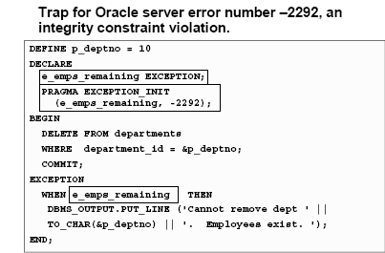
Non Predefined Exceptions
Example

Slide 18
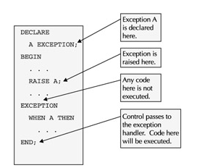
User Defined Exceptions
Trapping User-defined exceptions
  Declared in the declaration section.
  Raised explicitly with RAISE statements.

Slide 19
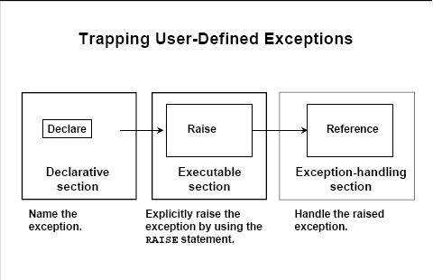
User Defined Exceptions

Slide 20
User Defined Exceptions
Example
DECLARE
out_of_stock EXCEPTION; -- DECLARE
number_on_hand NUMBER(4);
BEGIN
...
IF number_on_hand < 1 THEN
RAISE out_of_stock; -- RAISE
END IF;
EXCEPTION
WHEN out_of_stock THEN -- REFERENCE
-- handle the error
END;

Slide 21
User Defined Exceptions – Reraising
DECLARE
excep1 EXCEPTION;
BEGIN
BEGIN .
..
IF (condition) THEN
RAISE excep1;
END IF;
EXCEPTION
WHEN excep1 THEN
NULL;
RAISE;
EXCEPTION
WHEN excep1 THEN
log_error;
END;
Exception raised
Exception re raised

Slide 22
Exception Handling Contd..
2. Defining User-defined exceptions same as Pre-defined exceptions
User-defined exceptions defined of type EXCEPTION can have the same name as the predefined exceptions.
To handle predefined and user-defined exceptions in the same block separately, prefix the predefined exception with the word STANDARD followed by a dot (.).
A user-defined exception with the same name as a predefined PL/SQL exception overrides the predefined exception.
DECLARE
DUP_VAL_ON_INDEX EXCEPTION;
BEGIN
...
...
EXCEPTION
WHEN DUP_VAL_ON_INDEX
or
STANDARD.DUP_VAL_ON_INDEX THEN
...
... END;

Slide 23
Exception Handling Contd..
Example SQLCODE Values
SQLCODE Value | Description
0 | No Exception encountered
1 | User-defined exception
.+100 | NO_DATA_FOUND exception
Negative Number | Another Oracle server error number

Slide 24
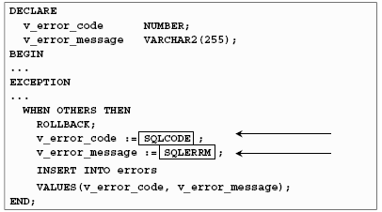
Exception Handling Contd..
Example

Slide 25
Exception Handling Contd..
Propagating Exceptions
Exceptions can occur in the declarative, the executable, or the exception section of a PL/SQL block.
When an exception is raised, if PL/SQL cannot find a handler for it in the current block or subprogram, the exception propagates.
That is, the exception reproduces itself in successive enclosing blocks until a handler is found or there are no more blocks to search.
Exceptions Raised in Executable section
When an exception is raised in the executable section of a block, PL/SQL uses the following algorithm to determine which exception handler to invoke:
If the current block has a handler for the exception, execute it and complete the block successfully. Control then passes to the enclosing block.

Slide 26
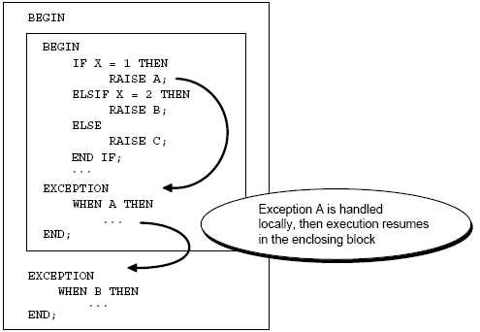
Exception Handling Contd..
Exception handled locally (inside the sub block)

Slide 27
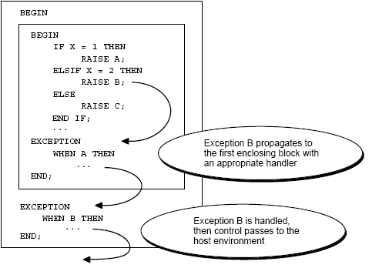
Exception Handling Contd..
Exception handled in the enclosing block

Slide 28
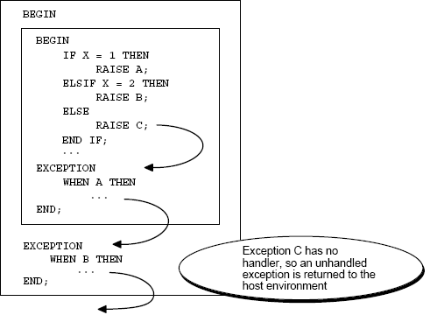
Exception Handling Contd..
Unhandled Exception

Slide 29
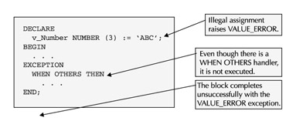
Exception Handling Contd..
Exceptions Raised in Declarative section – Example 1

Slide 30
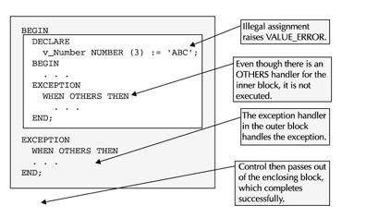
Exception Handling Contd..
Exceptions Raised in Declarative section – Example 2

Slide 31
Exception Handling Contd..
Exceptions Raised in Exception section
Exceptions can also be raised while in an exception handler, either explicitly via the RAISE statement or implicitly via a runtime error.
In either case, the exception is propagated immediately to the enclosing block, like exceptions raised in the declarative section.
This is done because only one exception at a time can be "active" in the exception section.
As soon as one is handled, another can be raised. But there cannot be more than one exception raised simultaneously.

Slide 32
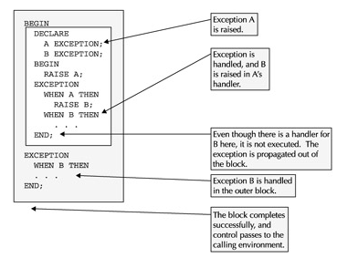
Exception Handling Contd..
Exceptions Raised in Exception section - Example 2

Slide 33
Exception Handling Contd..
Using RAISE_APPLICATION_ERROR procedure
The procedure RAISE_APPLICATION_ERROR lets you issue user-defined ORA error messages from stored subprograms.
You can report errors to your application and avoid returning unhandled exceptions.
Syntax
where
error_number is a negative integer in the range -20000 .. -20999.
message is a character string up to 2048 bytes long.
If the optional third parameter is TRUE, the error is placed on the stack of previous errors. If the parameter is FALSE (the default), the error replaces all previous errors.
raise_application_error(error_number, message[, {TRUE | FALSE}]);

Slide 34
Exception Handling Contd..
RAISE_APPLICATION_ERROR procedure can be used in two different places:
    Executable section
    Exception section
Returns error that is consistent with other Oracle server errors. The error number and message is displayed to the user.

Slide 35
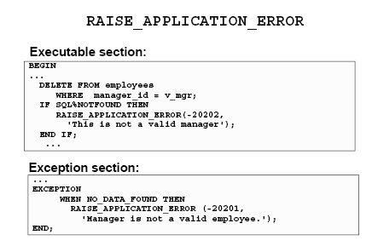
Exception Handling Contd..
  Example ,

Slide 36
Key Points to Remember
Categorize errors in your PL/SQL code by segregating them into predefined exceptions, non-predefined Oracle errors, user-defined exceptions, and user- defined PL/SQL error messages.
For all of these types of errors, write generic error-handling routines that separate error processing from business logic processing.

Slide 37
Best Practices
Best Practice | Benefits
Whenever multiple SELECT statements are used in a block, handle 'NO_DATA_FOUND' and 'TOO_MANY_ROWS' exceptions for each of the SELECT statements in the block | Indicates which SELECT statement has resulted in the exception. Debugging becomes easier
When naming user-defined exceptions, give suitable meaningful names inaccordance with the context. Although giving same name as predefined exceptions is permitted, avoid it. | Aids in better understanding and tracability.Avoids confusion.
Specify the WHEN OTHERS handler at the topmost level of your program. This handler may simply log the error and where it occurred. | Ensures no error goes undetected

Slide 38


Slide 39
Thank You

